Slide 1
Bear et al.: Neuroscience: Exploring the Brain (3rd edition)
Chapter 15: Chemical Control of the Brain and Behavior
Today’s focus: Autonomic Nervous system -- Sympathetic and Parasympathetic divisions

Slide 2
The Autonomic Nervous System
Divisions of autonomic nervous system (ANS)
Sympathetic division (fight or flight)
Increased heart rate and blood pressure
Depressed digestive function
Mobilized glucose reserves
Parasympathetic division (rest and digest)
Slower heart rate, fall in pressure
Increased digestive functions
Stop sweating

Slide 3
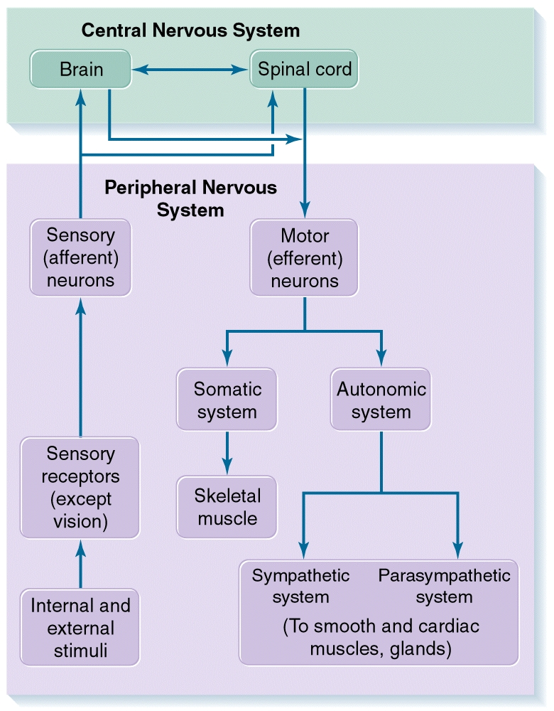

Slide 4
The Autonomic Nervous System
ANS Circuits versus Somatic Motor System
ANS
Actions multiple, widespread, slow
Widely coordinated and graded control
Commands all tissues and organs except skeletal muscle
Outside CNS
Disynaptic efferent pathways

Slide 5
The Autonomic Nervous System
ANS Circuits versus Somatic Motor System (Cont’d)
Somatic
Rapid and accurate
Only peripheral targets
Commands only skeletal muscle
Within CNS
Monosynaptic pathway

Slide 6
Fight-or-Flight Response

Slide 7
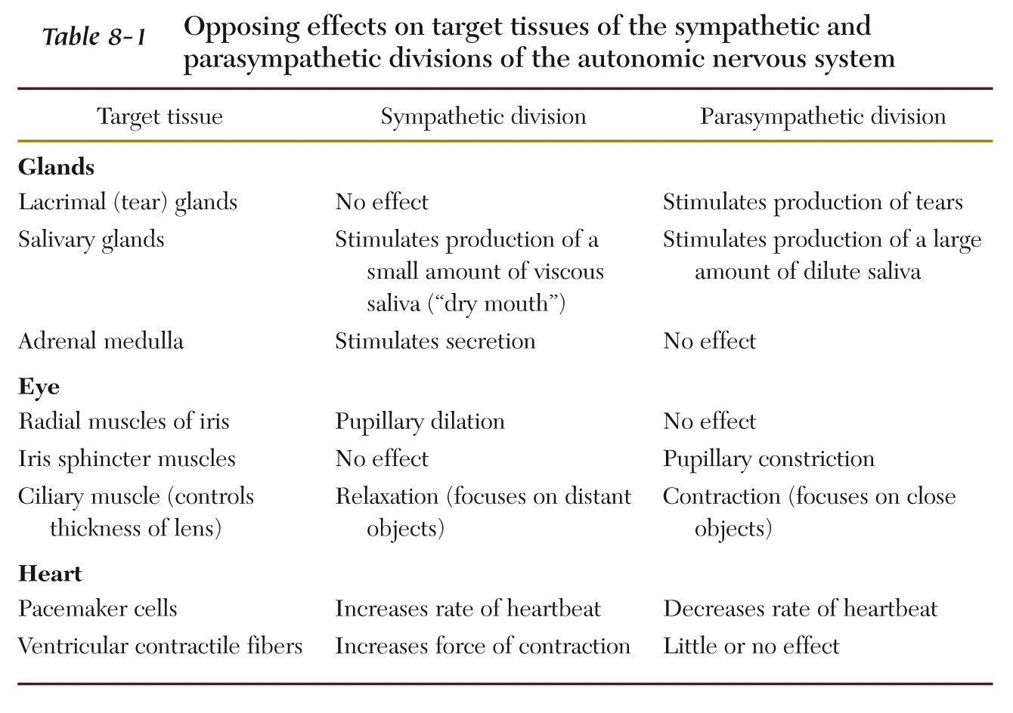

Slide 8
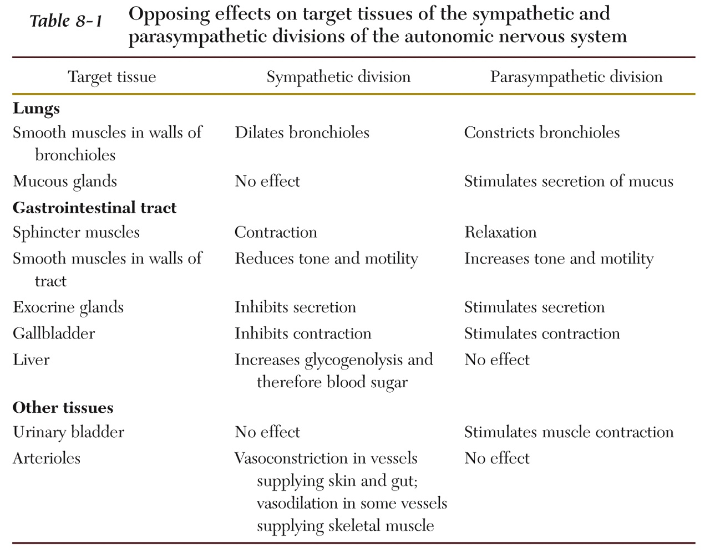

Slide 9
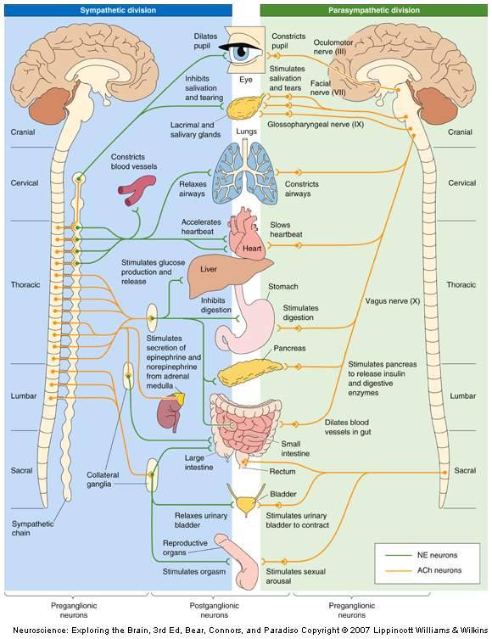
Sympathetic and Parasympathetic Divisions

Slide 10
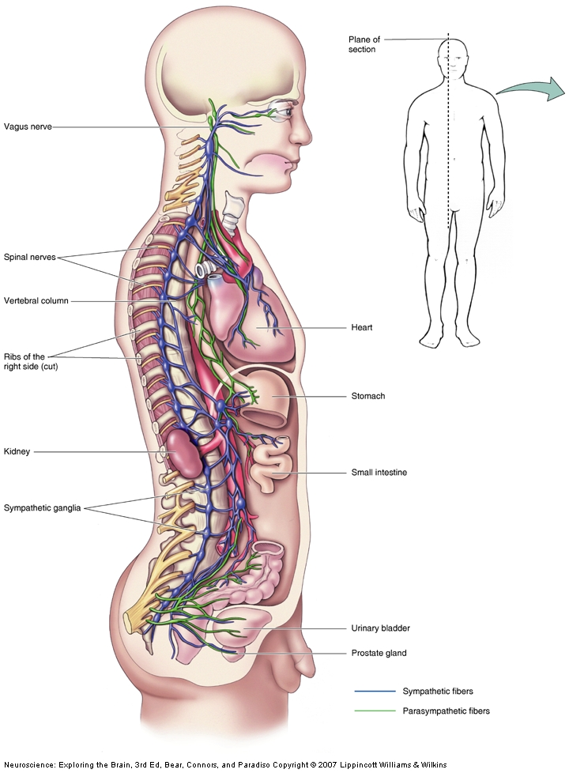

Slide 11
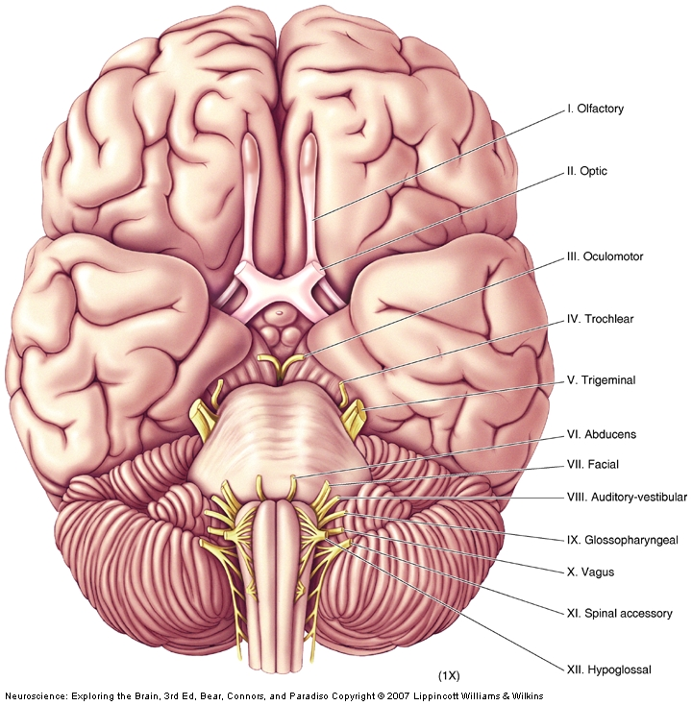
The 12 pairs of
Cranial Nerves
Mnemonic:
On Old Olympus’
Towering Top
A Finn And German
Viewed Some Hoes

Slide 12
Table 1. Cranial Nerves Summary
http://www.meddean.luc.edu/lumen/MedEd/grossanatomy/h_n/cn/cn1/table1.htm

Slide 13
The Autonomic Nervous System
The Enteric Division
Location: Lining of esophagus, stomach, intestines, pancreas, and gallbladder
Composition: Two complicated networks- myenteric (Auerbach's) plexus and submucous (Meissner's) plexus
Function: Control physiological processes involved in transport, digestion of food
Inputs: From brain via axons of the sympathetic and parasympathetic divisions

Slide 14
The Autonomic Nervous System
Central Control of the ANS
Connections for autonomic control
Periventricular zone connections to brain stem and spinal cord nuclei
Nucleus of solitary tract
Function of solitary nucleus
Integrates sensory information from internal organs and coordinates output

Slide 15
The Autonomic Nervous System
Neurotransmitters and the Pharmacology of Autonomic Function
ANS: Better understanding of drug mechanisms influencing synaptic transmission (vs. CNS)
Preganglionic Neurotransmitters
Primary transmitter: ACh
ACh: Binds to nAChR, evokes fast EPSP
Ganglionic ACh: Activates mAChR, slow EPSPs and IPSPs
Preganglionic terminals: Small EPSPs

Slide 16
The Autonomic Nervous System
Postganglionic Neurotransmitters
Parasympathetic: Release Ach
Local effect
Sympathetic: Release NE
Far-reaching effects
Parasympathomimetic: Mimic or promote muscarinic actions of ACh or inhibit actions of NE
Sympathomimetic: Mimic or promote NE actions or inhibit muscarinic actions of ACh

Slide 18
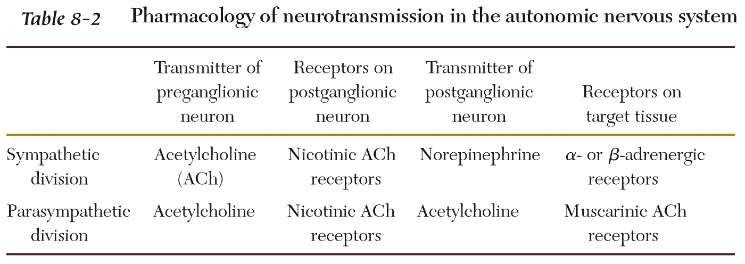

Slide 19
http://en.wikipedia.org/wiki/Adrenergic_receptor

Slide 20
http://www.youtube.com/watch?v=5ePYet3Fbts&feature=related
Why Zebras don’t get Ulcers
http://www.youtube.com/watch?v=hrCVu25wQ5s
Robert Sapolsky – uniqueness of humans

Slide 21
Robert Sapolsky’s Reduce Stress Summary
Perspective. You probably have enough food to eat, and you probably won’t get eaten by a lion on the way home.
Take time to groom someone.
Don’t get gored! (it can cause sepsis).

Slide 22
Fight-or-Flight Response

Slide 23
General Adaptation Syndrome (GAS)
Alarm & mobilization stage
Become aware of stressor
Resistance stage
Preparation to fight the stressor
Exhaustion stage
Negative consequences of stress appear

Slide 24
Mnemonic The word "cushingoid" is a useful way to consider the complications and symptoms of Cushing's Cataracts, Ulcers, Skin: striae, thinning, bruising, Hypertension/ hirsutism/ hyperglycemia, Infections,Necrosis, avascular necrosis of the femoral head, Glycosuria, Osteoporosis, obesity, Immunosuppression, and Diabetes

